Slide 1
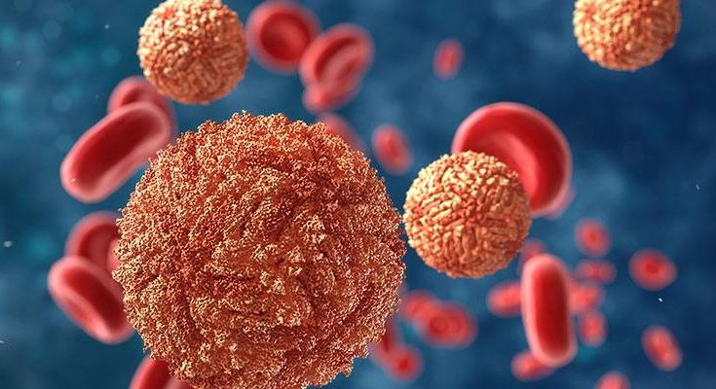
A brief epidemiologic examination of selected communicable diseases in the state of California
Fang (Amy) Liu
BMIN 5030 Data Science for Biomedical Informatics Final Project
Fang.Liu1@Pennmedicine.upenn.edu
11/30/23

Slide 2
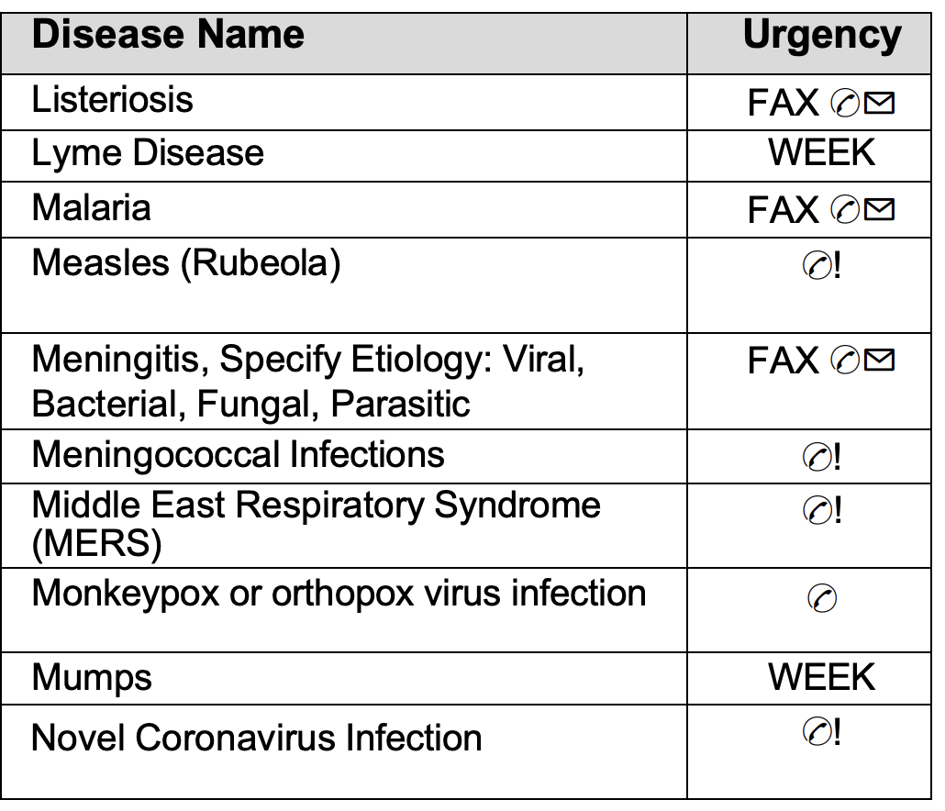
Background
The California Department of Public Health (CDPH) maintains a passive reporting system for a list of communicable disease cases and outbreaks mandated by state law and regulation.
Healthcare providers are required to report cases of these diseases to local health departments, which in turn report these cases to the CDPH.
Notes:
https://www.cdph.ca.gov/Programs/CID/DCDC/CDPH%20Document%20Library/ReportableDiseases.pdf
FAX ✆✉ = Report by electronic transmission within one working day of identification
WEEK = reported within seven calendar days of identification

Slide 3
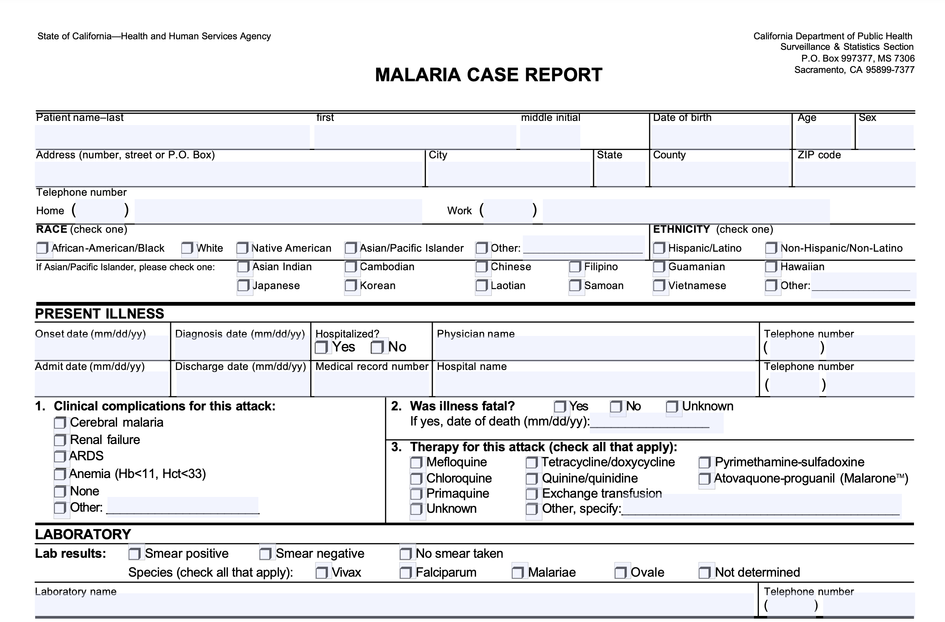
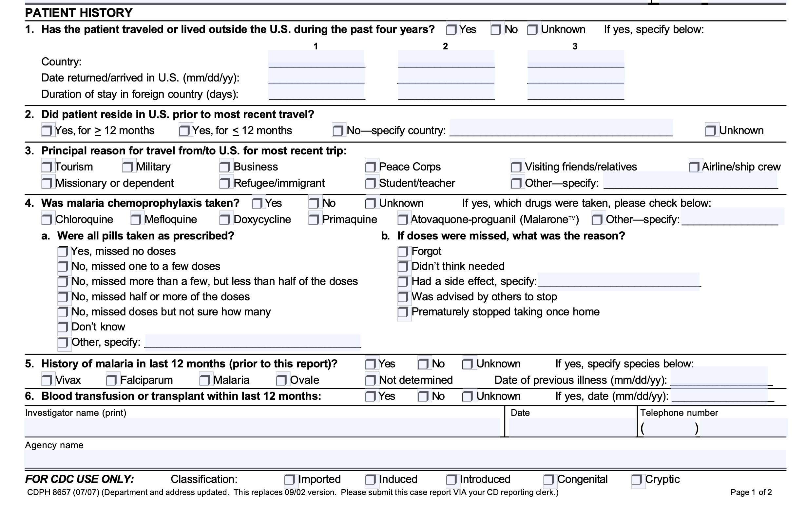
Notes:
http://publichealth.lacounty.gov/acd/Diseases/EpiForms/Malaria%20Case%20Report-CDPH%208657.pdf

Slide 4
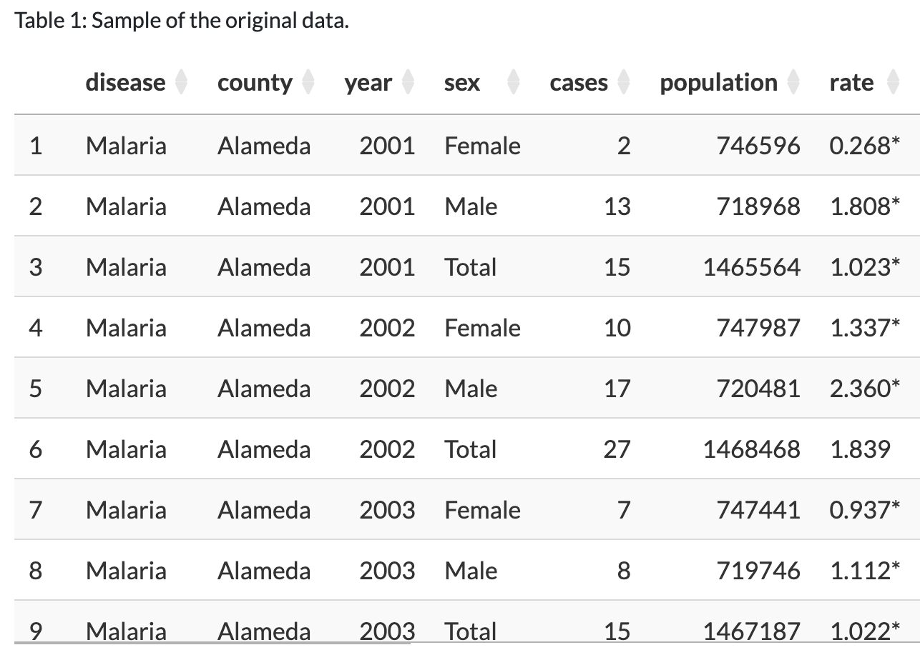
Data
Public dataset released by CDPH
Data represent cases with an estimated illness onset date from 2001 through 2021
Incidence rate = # of cases per 100,000 population
(Cases *100,000)/population
Notes:
https://catalog.data.gov/dataset/infectious-diseases-by-disease-county-year-and-sex-d8912

Slide 5

Methods
Data is aggregated across all years and the top 10 diseases by cumulative case count were identified.
Assess annual trends for selected diseases to see if there has been a drastic decrease or increase in cases over the years.
Explored the spatial distribution for each disease to identify which region or population are affected more.

Slide 6
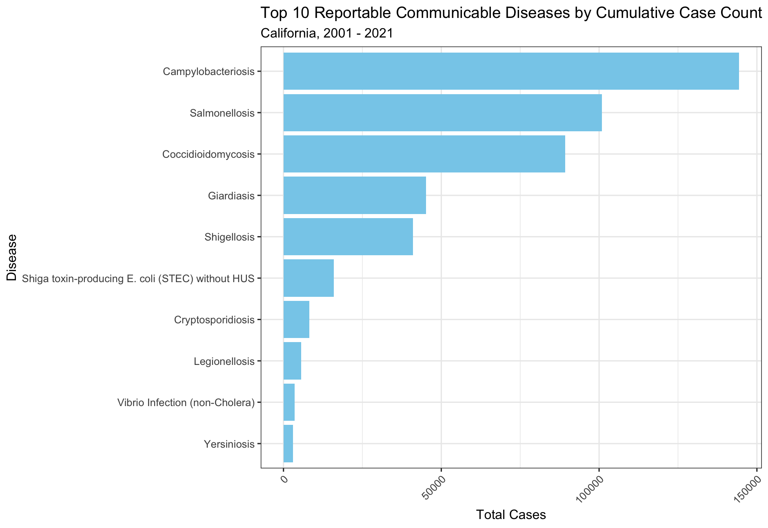
Results
Top 3 diseases by case count:
Campylobacteriosis
Salmonellosis
Coccidioidomycosis
Notes:
kok-SID-ee-oy-doh-my-KOH-sis

Slide 7
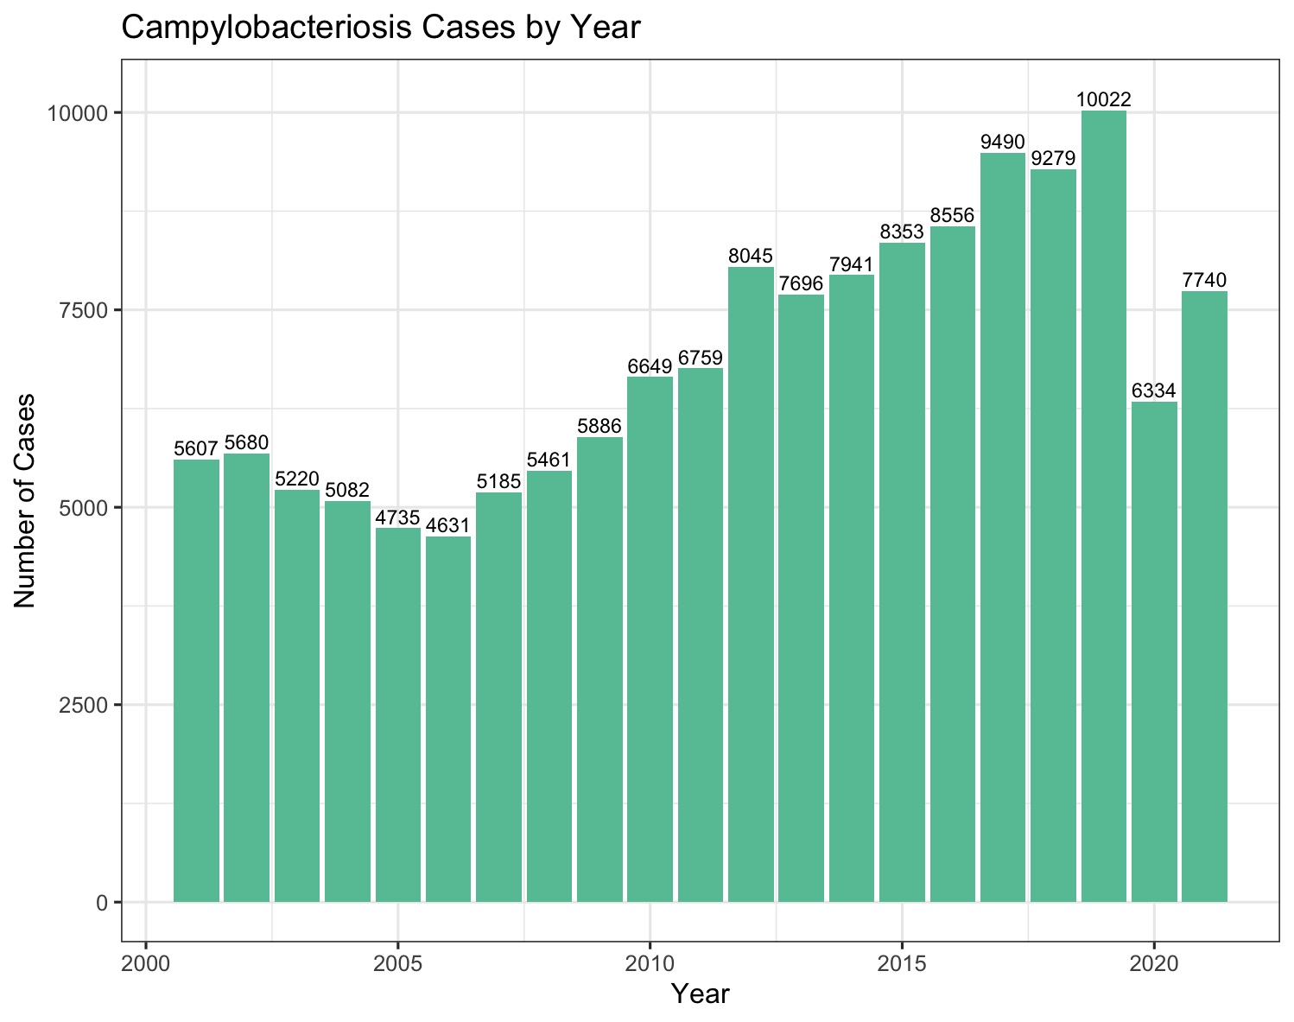
Campylobacteriosis
Campylobacter is the #1 cause of bacterial diarrheal illness in the United States
People often get Campylobacter infection by eating raw or undercooked poultry
# of people who get sick from the Campylobacter bacteria has been increasing steadily since 2006
significant drop observed in 2020 is likely impacted by COVID
Notes:
Coccidioidomycosis
The significant drop observed in year 2020 is likely impacted by COVID, an timepoint at which most health resources are divested toward controlling the new SARs-Cov2 Virus.

Slide 8
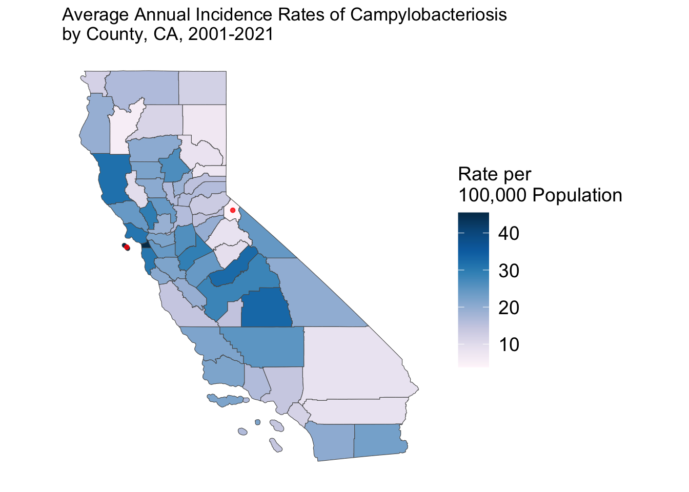
The average annual rate of new campylobacteriosis cases during 2001-2021 was about 19 cases per 100,000 people in California.
The average rates were highest in San Francisco County (about 45 cases per 100,000 people) and lowest in Alpine County (4 cases per 100,000 people).

Slide 9
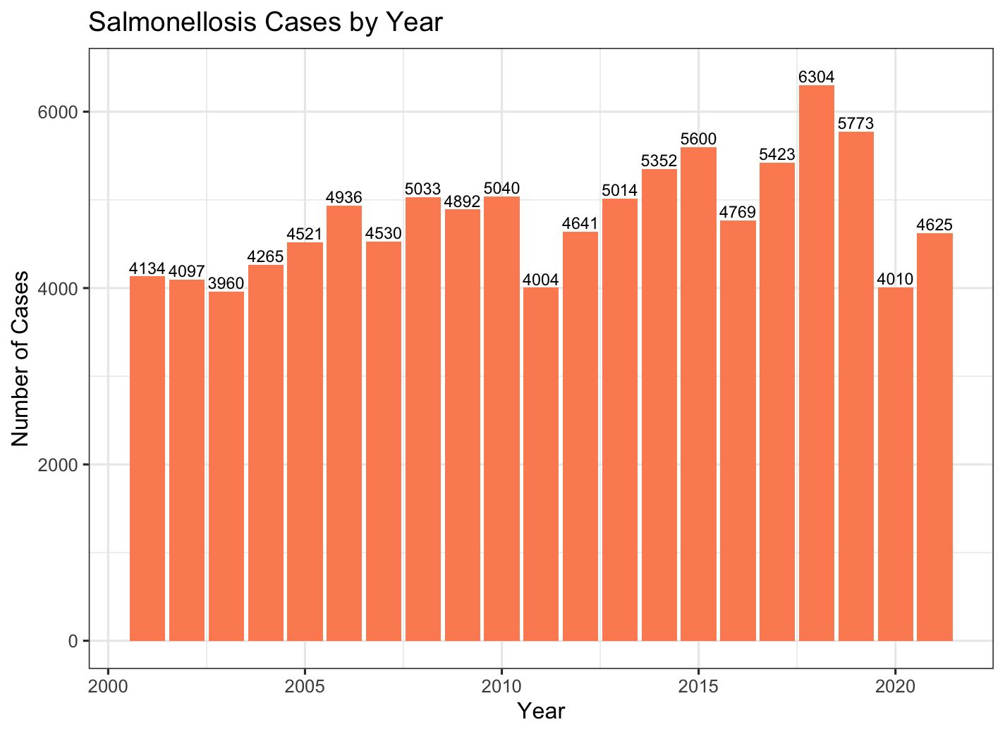
Salmonellosis
Salmonellosis is an bacterial infection caused by Salmonella, which usually live in the intestinal tracts of animals.
Salmonella are usually transmitted to humans by eating foods contaminated with animal feces (e.g., poultry, pork).
Cases have been fairly stable

Slide 10
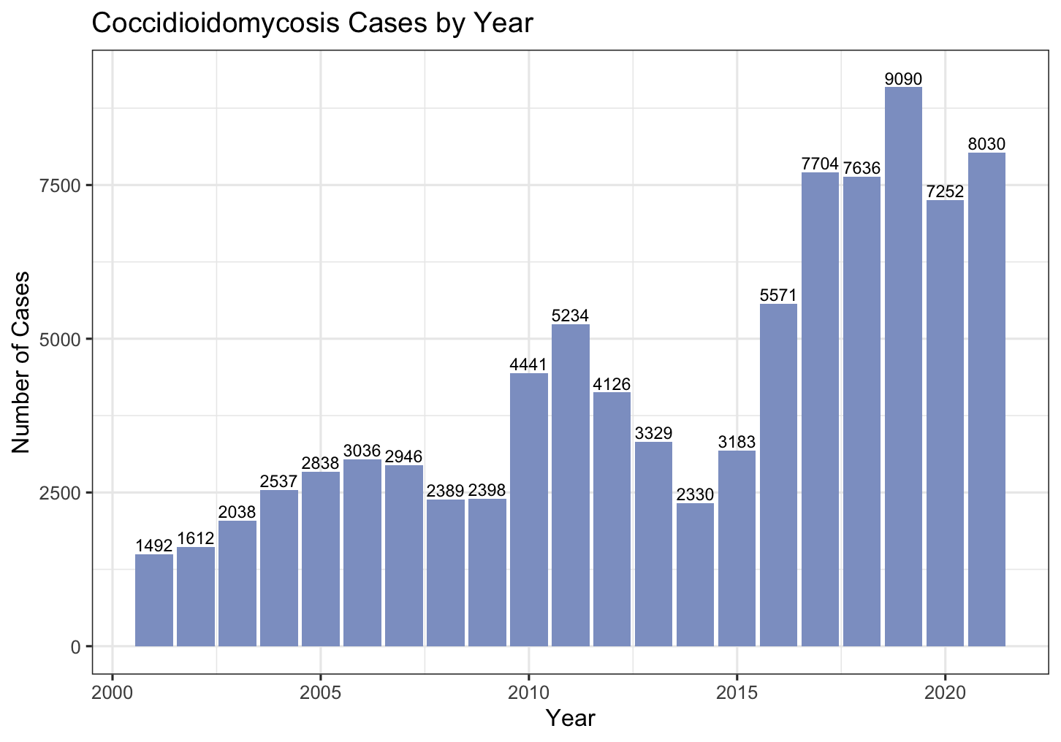
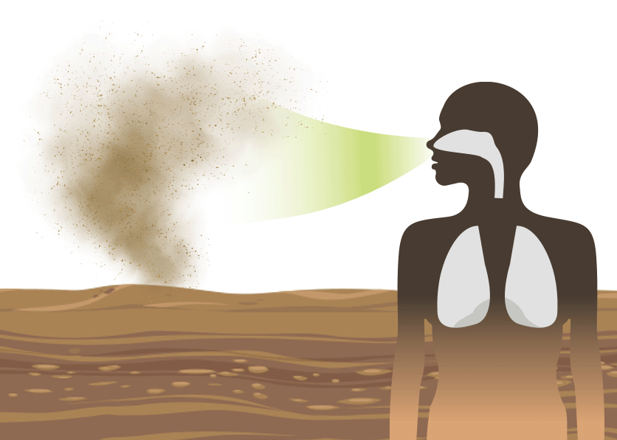
Coccidioidomycosis
Cocci or Valley fever is caused by a fungus that grows in the soil and dirt in some areas of California and southwestern US.
People get sick when they breathe in dust that contains Valley fever fungus.
Valley fever can be serious and fatal. Currently there is no vaccine to prevent cocci but antifungal medications are available.
https://www.cdph.ca.gov/Programs/CID/DCDC/Pages/Coccidioidomycosis.aspx
Notes:
Kaak-see
https://www.cdph.ca.gov/Programs/CID/DCDC/Pages/Coccidioidomycosis.aspx

Slide 11
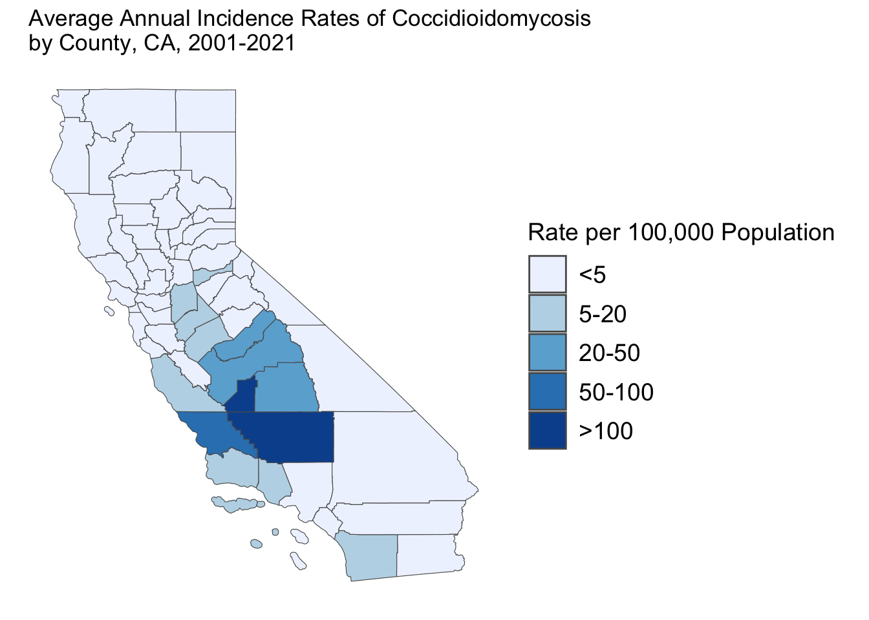

Most cases of Valley fever in California are reported in people who live in the Central Valley and Central Coast regions.
Central Valley is known for its agricultural productivity; provides more than half of the fruits, vegetables, and nuts grown in the United States
The average annual incidence rate from 2001 to 2021 was highest in Kern County (207 per 100,000), followed by Kings County (114 per 100,000)

Slide 12
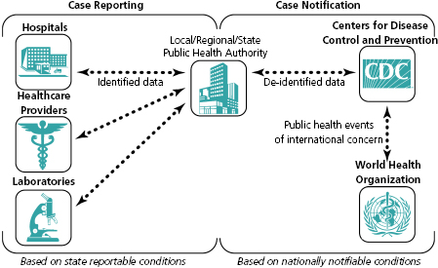

Discussion
Great exercise using an actual surveillance dataset to extract patterns and see how data can be used to inform decision-making
Tracking and monitoring these diseases is very important because it helps us:
understand the magnitude and burden of specific diseases
identify potential risk groups
Design targeted intervention strategies & assess the effectiveness of control or prevention efforts
Increasing globalization & climate change → spill-over events!
Surveillance is a fundamental bedrock of public health!
Notes:
Public health surveillance is itself a really interdisciplinary team effort - first you need providers and laboratories reporting these cases to local health departments, which is potentially followed by fieldwork to examine and identify sources of outbreaks, then the Department of Health aggregates these information across regions and entire data analyst teams are dedicated to cleaning and extracting valuable information from the data to identify potential risk factors and inform future prevention planning.

Slide 13
Relevant Links
Data can be downloaded at: https://catalog.data.gov/dataset/infectious-diseases-by-disease-county-year-and-sex-d8912
Reportable communicable diseases: https://www.cdph.ca.gov/Programs/CID/DCDC/CDPH%20Document%20Library/ReportableDiseases.pdf
Infectious diseases case report forms: https://www.cdph.ca.gov/Programs/PSB/Pages/CommunicableDiseaseControl.aspx
CDC Campylobacter Page https://www.cdc.gov/campylobacter/index.html
CDPH Valley Fever Page https://www.cdph.ca.gov/Programs/CID/DCDC/Pages/Coccidioidomycosis.aspx
Example epidemiological summaries released by CDPH https://www.cdph.ca.gov/Programs/CID/DCDC/Pages/EpiSummariesofCDsCA.aspx

